Slide 1
"SECURIGRAPHY: TEXT ENCRYPTION AND STEALTHY IMAGE COMMUNICATION"
INFORMATION SECURITY PROJECT
~VEJA ODEDARA [21BCP404]
~MANSI BHADANI [21BCP167]

Slide 2
CONTENT INDEX
INTRODUCTION
MOTIVATION
BENEFITS
LIMITATIONS
FUTURE SCOPE
REFERENCES

Slide 3

INTRODUCTION
IMAGE STEGANOGRAPHY IS THE PROCESS OF HIDING INFORMATION WHICH CAN BE TEXT, IMAGE OR VIDEO INSIDE A COVER IMAGE. THE SECRET INFORMATION IS HIDDEN IN A WAY THAT IT NOT VISIBLE TO THE HUMAN EYES.

Slide 4
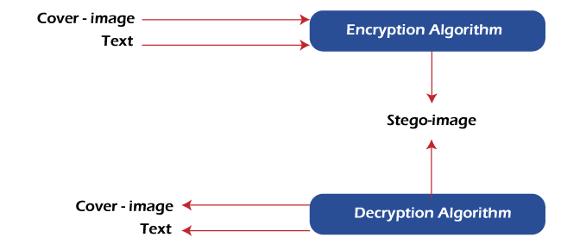

Slide 5
MOTIVATION
1
PRIVACY AND SECURITY:
Protecting sensitive information is a primary motivation. Combining encryption and steganography ensures that your messages are not only hidden but also secured from unauthorized access.
2
SECURE COMMUNICATION:
This project can be useful for individuals or organizations that need to communicate privately or securely over public channels, such as email or social media.

Slide 6
BENEFITS
1
VERSATILITY:
This project offers versatility, as you can use different encryption methods and steganographic techniques to adapt to various scenarios and security requirements.
2
ENHANCED SECURITY:
By combining encryption and steganography, you can create a multi-layered approach to protect sensitive information, making it more challenging for unauthorized individuals to intercept or access the data.
3
RESISTANCE TO EAVESDROPPING:
By encrypting the data before embedding it in an image, you add an extra layer of protection, making it more resilient against eavesdropping and interception.

Slide 7
LIMITATIONS
LIMITED DATA CAPACITY
KEY MANAGEMENT
INCREASED FILE SIZE
The amount of data that can be hidden within an image is limited by the image's size and complexity. This may not be suitable for transmitting large amounts of data.
Managing encryption keys is crucial for the security of the project. If key management is not handled properly, it can compromise the entire system.
Embedding data within images can increase the size of the image, which may not be ideal in cases where file size needs to be minimized.

Slide 8
FUTURE SCOPE
CONTENT PROTECTION AND COPYRIGHT
MACHINE LEARNING AND AI INTEGRATION
Further applications in digital watermarking and content protection could emerge, allowing creators to protect their intellectual property online.
3D and VR Environments: With the increasing use of 3D media and virtual reality (VR), watermarking techniques will need to adapt to protect and verify the ownership of immersive content.
The integration of machine learning and artificial intelligence in steganography and encryption could provide more robust security and detection techniques.
BLOCKCHAIN AND CRYPTOCURRENCIES
The integration of steganographic methods in blockchain technology or cryptocurrency transactions could enhance privacy and security.

Slide 9
REFERENCES
https://www.geeksforgeeks.org
https://ieeexplore.ieee.org
dl.acm.org

